Slide 1

DS Presentation
<<Social Sector-Wise Aggregated Expenditure Analysis (2016–2022)>>
Bharti Ingle
PRN No. : 22070521039
Sem: 7
Mentor : Piyush Chauhan
Symbiosis Institute of Technology, Nagpur Campus

Slide 2

Problem Statement:
Can historical expenditure data (2016–2021) from various Indian states across social sectors be effectively analyzed to understand expenditure distribution and trends, assisting in data-driven policy and budget allocation?

Slide 3
Objective:
To study state-wise social sector expenditures from 2016–2022 to identify major spending trends, relationships between key sectors, and generate predictive insights that support better policy decisions and future budget planning.

Slide 4
Dataset Overview:
Source: Government expenditure datasets (social sector data)
Timeframe: 2016–2022
Scope: Various Indian states and union territories
Key Variables:
• State/Region
• Year
• Sector (Health, Education, Rural Development, etc.)
• Total Expenditure

Slide 5
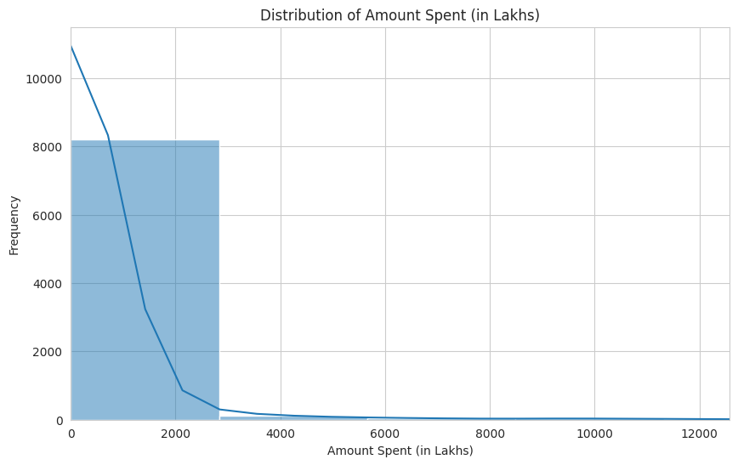
Exploratory Data Analysis:
State-wise expenditure visualized using bar and line plots
• Yearly spending trends analyzed across multiple sectors
• Correlation Heatmap revealed strong positive relationships among education, health, and rural development spending
• Expenditure showed an increasing trend post-2019

Slide 6
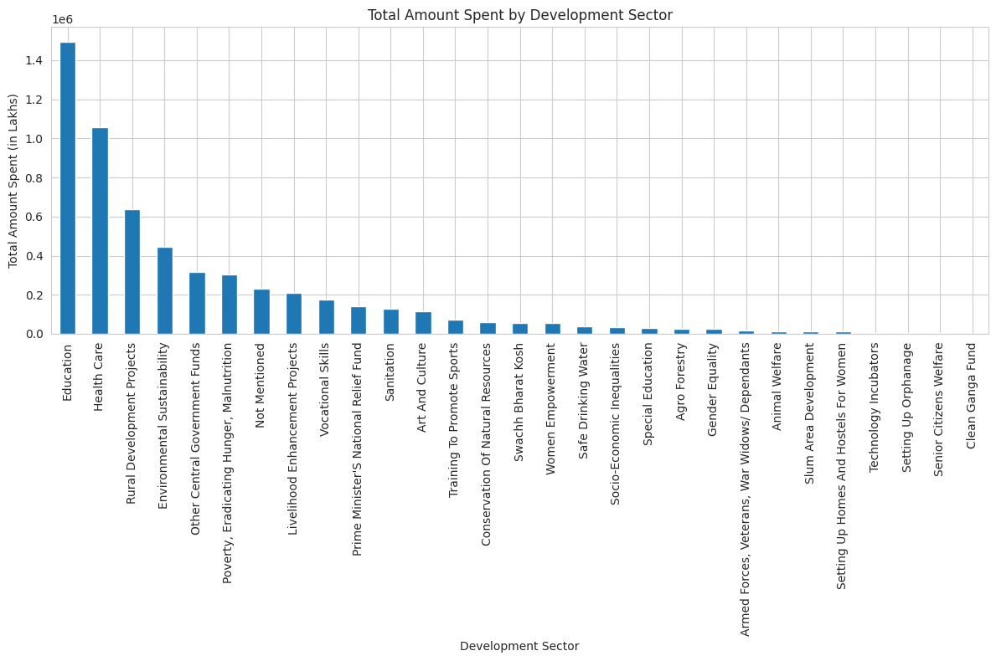
Visualization Highlights:
Correlation Heatmap: Inter-sector relationships
• Trend Analysis: Year-over-year spending rise
• Sectoral Comparison: Education and Health dominate
• Regression Output Plot: Predicted vs. Actual alignment shows stability

Slide 7
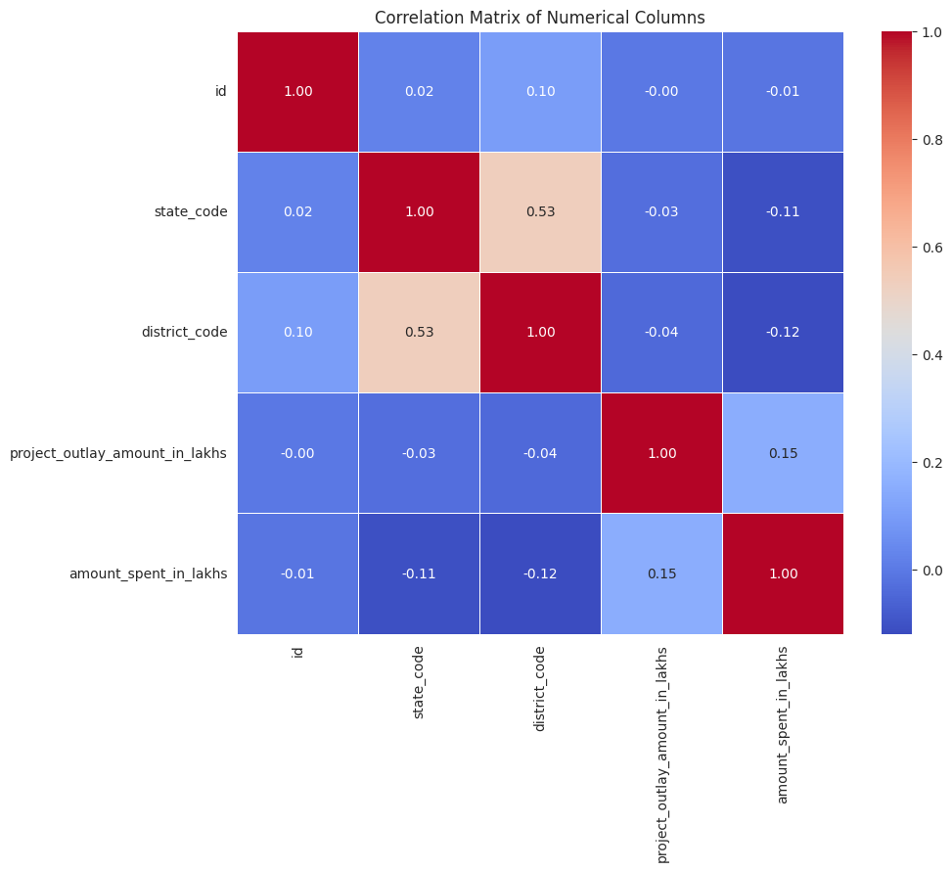
Conclusion and Future Scope:
Social sector expenditure in India is on a steady upward trend
• State-wise differences highlight the need for targeted policy design
Future Scope:
• Use advanced ML models (Random Forest, XGBoost)

